Slide 1
GLENEAGLE SECONDARY
GRADE 12 INFORMATION SESSION

Slide 2
KEY CONTACT PEOPLE
Mr. Cober Principal
Ms. Zimmer Vice Principal (A-H)
Mr. Chan Vice Principal (I-Pa)
Ms. Cuellar Vice Principal (Pe-Z)
Mr. Henry Counsellor (A-F, X)
Ms. Butterfield Counsellor (G-Lee)
Ms. Young Counsellor (Lef-R)
Ms. Duarte Counsellor (S-W, Y-Z)
Flora Youth Worker
Ms. Yang International Youth Worker- Mandarin
Ms. Jeoung International Youth Worker- Korean
Ms. Mohammadpour International Youth Worker - Farsi
Ms. Clark Youth Worker Aboriginal Education
Ms. Austman Post-Secondary & Career Advisor/Scholarships
Ms. Chung Commencement
Ms. Demonte Career Life Connections Co-ordinator

Slide 3
GRADUATION REQUIREMENTS
REQUIRED COURSES
Career Life Education 10
English 10
English 11
English 12
Mathematics 10
Mathematics 11
Fine Arts and/or Applied Skills 10, 11 or 12
Social Studies 10
Social Studies 11 or one of: Comparative Cultures 12, Genocide Studies 12, History 12,
Physical Geography 12, Law 12, or Philosophy 12
Science 10
Science 11
Physical Education 10
Total 48 credits for required courses

Slide 4
GRADUATION REQUIREMENTS
28 Elective credits from grade 10-12 courses
Career Life Connections (CLC) – 4 credits
Total credits overall is 80
Of the 80 credits for graduation, at least 16 credits must be at the Grade 12 level, including English 12
Numeracy Assessment
There is no Literacy Assessment for this year’s grade 12 students

Slide 5
Career life connections 12 & Capstone project
Mr. Bingley Mr. Henry
Mrs. Demonte Ms. Butterfield
Mrs. Upton Ms. Duarte
Mr. Unger Ms. Young
You will be assigned to one of the
"dream team" members as your CLC contact/mentor

Slide 6

What you need to know…
  We will be using “Class Notebook in OneNote” → You can find your assignments in the “CONTENT LIBRARY”
  There will be 7 Tabs (Under each tab will be an Assignment)
  1. My BluePrint Graduation (10%)
  2. Personal Career Life Development (10%)
  3. Connections to the Community with 30hrs Work/Volunteer Experience (10%)
-Hours can start to count starting summer after Grade 9
-Hours must be completed in the Lower Mainland
-Hours CANNOT be tied to course credits (Work Exp/Leadership/Con’x/Active Living/Athletic Leadership/Theater Production etc.)
***If uncertain whether hours are valid please contact your CLC12 teacher
4. Career Life Connections/Resume (10%)
5. Financial Plan (10%)
6. Core Competencies (10%)
7. Capstone Project (40%)

Slide 7
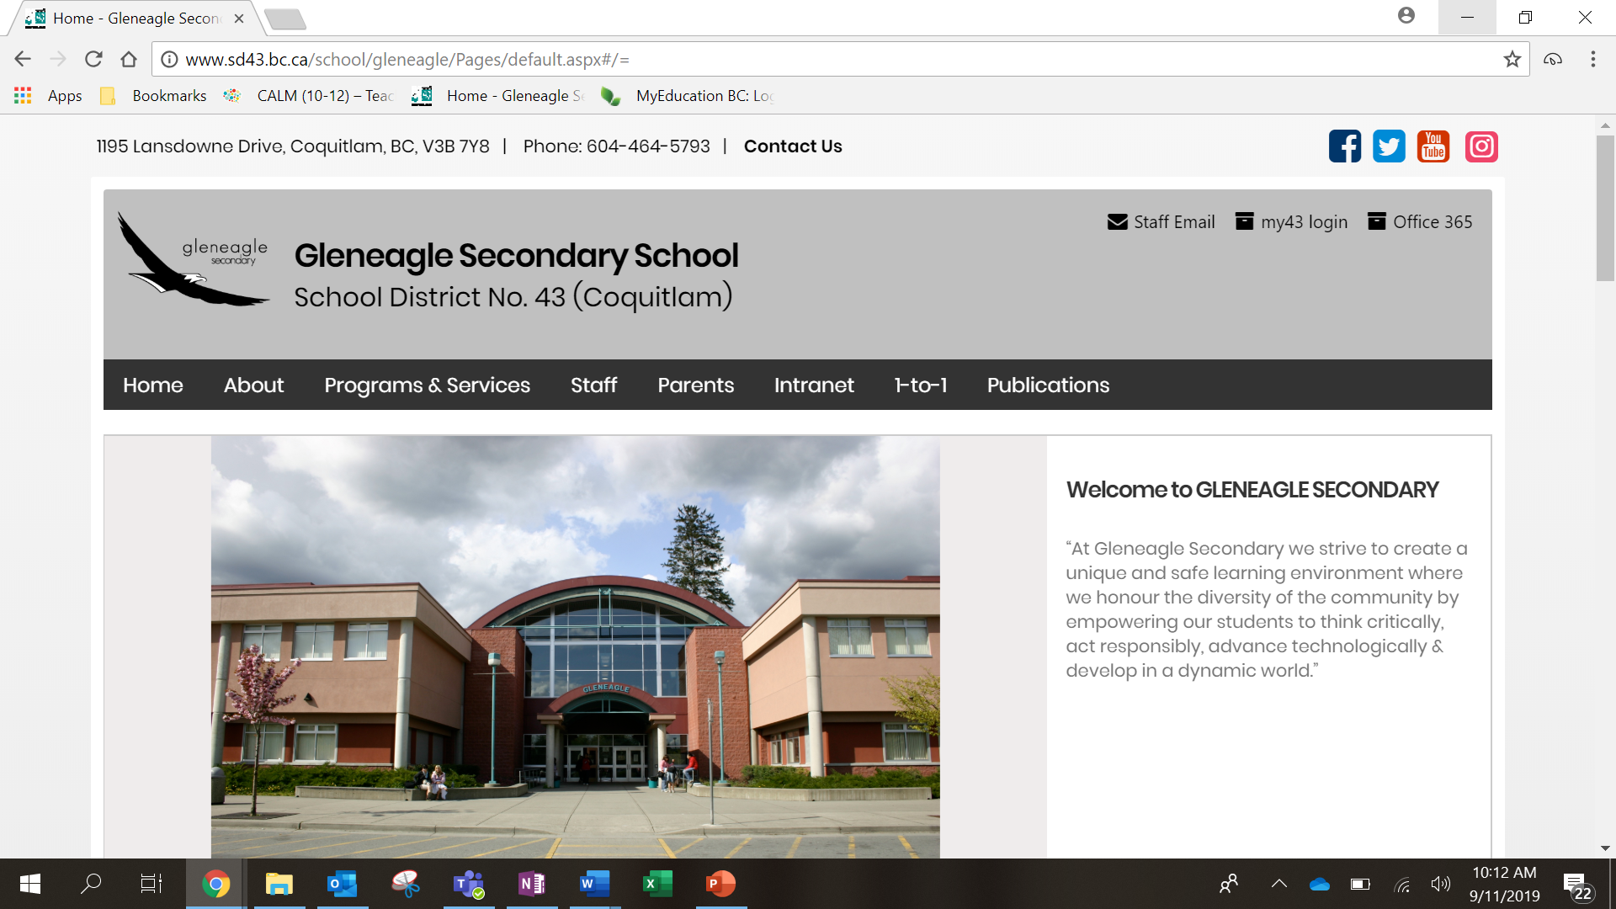
1

Slide 8
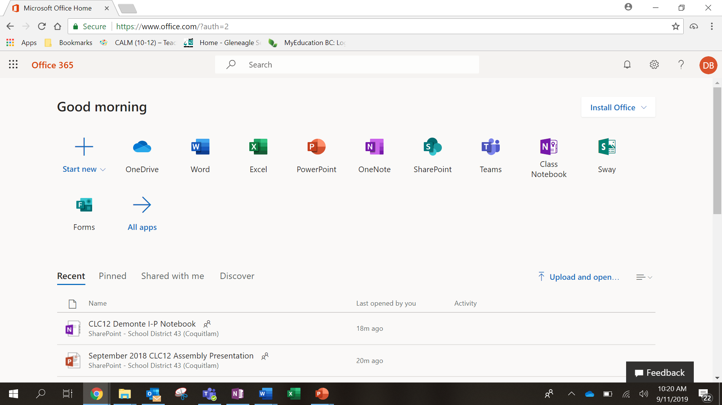


Slide 9

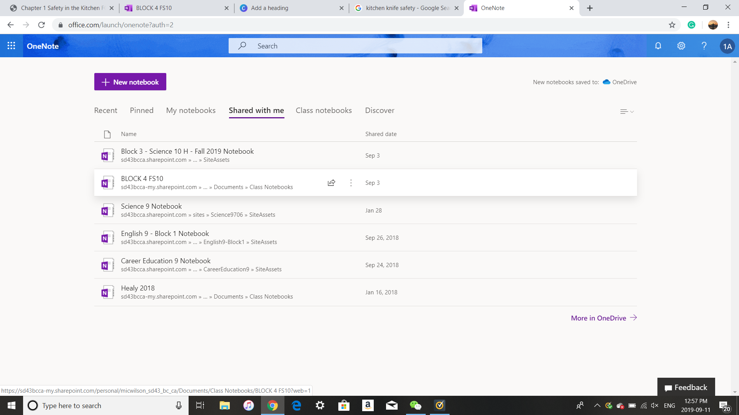

Slide 10

Important dates
Early Grads
Career Life Connections Assignments
DUE: Friday, December 20st
Capstone Project
DUE: Friday, Jan 10th – OR EARLIER (By appointment only with your assigned teacher)
Regular Grads
Career Life Connections Assignments
DUE: Assignments will have individual due dates T.B.A. approx. 1 per month... will have them up and ready to go shortly
Capstone Project
DUE: T.B.A. (Usually Mid-April)

Slide 11
Do’s & Don'ts
Read the instructions carefully for each assignment!!!!
Provide DETAIL & reflection in your answers.
No one-worded answers!!!!
Assignments can only be handed in ONCE – SO…do it right the 1st time!
NEW THIS YEAR!!! You will now be receiving a FINAL letter grade for this course that will be on your transcript
ALL assignments must be completed in order to receive a grade and credit for the course

Slide 12

CLC12 & CAPSTONE INCOMPLETE?
You CANNOT go to GRAD dinner-dance if you don’t complete your CLC12 assignments and Capstone project…oh, and you CAN’T GRADUATE either!

Slide 13
POST-SECONDARY REQUIREMENTS
Entrance requirements differ for each post-secondary institution.
Check post-secondary institutions’ websites.
Entrance requirements change over time.
Most post-secondary institutions are also looking at Grade 11 final marks and a personal portfolio.
Look for:
date applications open - some are already open!
deadlines for applications.
admission requirements – for specific institutions as well as faculties within those institutions.
deadline for completion of online courses.

Slide 14
POST-SECONDARY INSTITUTION (PSI)
CHOICES FORM
The PSI Choices form is an online document that can be accessed through:
www.studenttranscripts.gov.bc.ca
This form is for you to give permission to the B.C. Ministry of Education to release your transcript to Post-Secondary Institutions of your choice.
PSI Choices Assembly to explain how to fill out the form on November 7th – CL time - MPR

Slide 15
PSI continued
Before the November 7th assembly, you must set up your account with the Student Transcript Service:
www.studenttranscripts.gov.bc.ca
You will create a BCeID using your PEN (9 digit Provincial Education Number, found on your report card). Ensure you do this prior to the November 7th assembly!

Slide 16
SCHOLARSHIP INFORMATION
Contact people: Ms. Austman (Post-Secondary & Career Advisor)
Ms. Young (Counsellor)
Scholarship Meetings:
#1. September 25th @ Lunch in the Library Computer Lab
#2. November 20th @ Lunch in the Library Computer Lab
#3. January 15th @ Lunch in the Library
#4. February 19th @ Lunch in the Library
#5. March 10th @ Lunch in the Library (local scholarship package)
SCHOLARSHIP PACKAGES DUE BY April 1st
*Please look at the Career Center website for the most up to date information

Slide 17
Canadian Universities Event
October 9th 6:00-8:00pm Gleneagle Gym
Not sure where you want to study next year? Curious about various
programs?
The Canadian Universities Event brings together representatives from over 50 Canadian universities to showcase their programs.
This is an excellent opportunity for you and your parents/guardians to connect with schools and ask questions.
Please see the Career Centre channel or webpage for a list of participating institutions.

Slide 18
POST-SECONDARY INSTITUTION MINI FAIR
October 29th 6:00 - 8:00pm Multi Purpose Room (MPR)
BCIT
Canadian Arm Forces – Royal Military College
Capilano University
Douglas College
Kwantlen Polytechnic University
Nicola Valley Institute of Technology
Selkirk College
Simon Fraser University
Thompson Rivers University
Trinity Western University
University of Victoria
University of the Fraser Valley
University of Northern BC
Vancouver Community College
Vancouver Island University

Slide 19
Post-Secondary School Visits
Canadian Universities Event October 9, 2019 6:00-8:00pm Gym
Queens University October 11, 2019 Lunch Library Lab
University of Toronto October 16, 2019 Lunch Library Lab
University of Calgary October 21, 2019 Lunch Library Lab
UBC October 21, 2019 6:00-7:00pm MPR
University of Guelph October 23, 2019 3:00-3:30pm Front Foyer
Western University October 24, 2019 Lunch Library Lab
BC Post-Secondary Fair October 29, 2019 6:00-8:00pm MPR
SFU Beedie School of Business November 5, 2019 Lunch Library
UVic Gustavson School of Business November 7, 2019 Lunch Library Lab
SFU November 14, 2019 Lunch Library
Kwantlen Polytechnic University November 18, 2019 Lunch Library Lab
University of Waterloo November 22, 2019 Lunch Library Lab
University of Alberta November 22, 2019 2:20-2:50pm Library Lab
McGill University November 25, 2019 Lunch Library Lab
Ryerson University (tentative) November 26, 2019 Lunch Library Lab

Slide 20
POST-SECONDARY & CAREER ADVISOR INFO.
(scholarships, post-secondary, volunteer, employment & other opportunities):
Career Centre Website:
Gleneagle > Programs & Services > Career Centre
http://www.sd43.bc.ca/school/gleneagle/ProgramsServices/career/Pages/default.aspx#/=
My School Day APP – Subscribe to Career Centre Channel

Slide 21
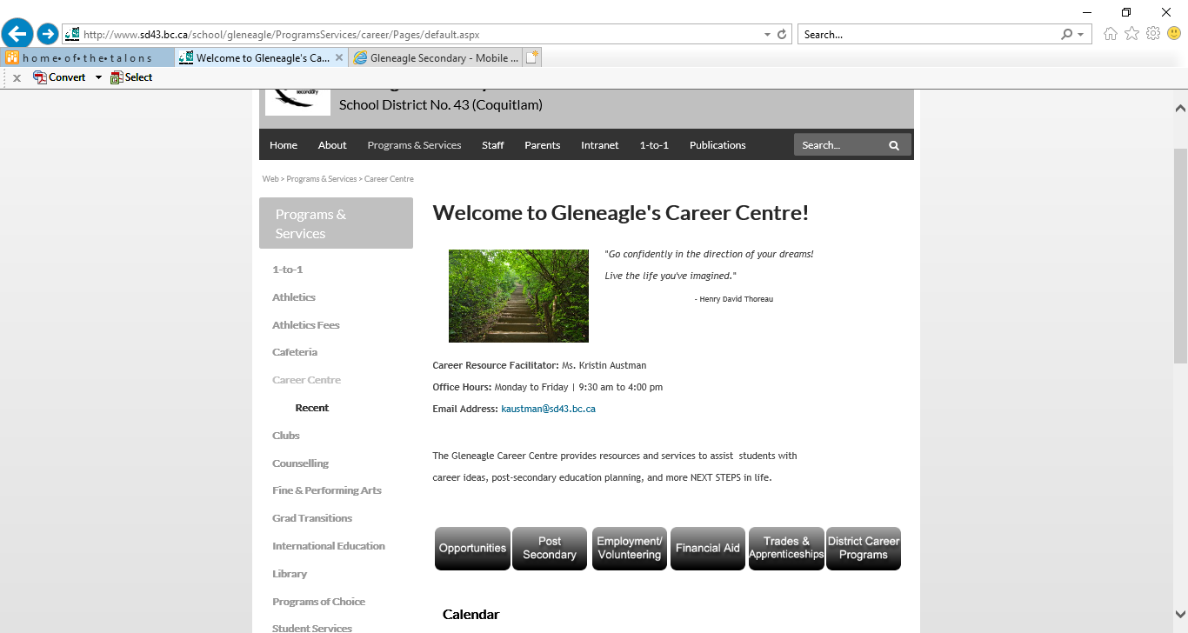
Live Links
Scroll Down
to see:

Slide 22
AWARDS CEREMONY
Date: June 3, 2020
Time: 7:00pm
Location: Gleneagle Gym

Slide 23
VALEDICTORIAN
A Grade 12 student is chosen from the graduation class of their peers. The chosen student prepares a speech that is given to the graduating class at the commencement ceremony.
The following criteria determine a Grade 12 student’s eligibility for participation in the choosing of the valedictorian:
1. Be in a graduating position at the time of the valedictorian nomination, including all Career Life Connections requirements completed
2. Have Grade 12 Honour Roll standing
3. Be in good standing with respect to work habits, achievement and school citizenship
4. Have 10 student nominations and 2 teacher signatures supporting the nomination

Slide 24
VALEDICTORIAN SELECTION
  April 27th – Valedictorian application forms available for pick - up
  May 4th – Valedictorian application forms due
  May 8th – Successful candidates will be informed
  May 14th – Valedictorian Speeches
  May 15th – Valedictorian Voting @ Lunch

Slide 25
Commencement
Date: June 14, 2020
Students arrive at 10:00am
Ceremony starts at 11:00am
Location: Orpheum Theatre
Tickets: Each student will receive 3 free tickets. If more are required a $5.00 fee per ticket is charged
All tickets must be purchased in advance
Students must be in a graduation position in order to cross the stage

Slide 26
Commencement Ceremonies Information Survey
https://bit.ly/2lIyX0T
Please complete the survey by October 15

Slide 27
GRAD DINNER & DANCE
Date: June 20, 2020
Time: 6:00 pm -12:00 am
Student must stay until 11:00pm
Location: Vancouver Convention Centre
Cost: Approx. $140
Bus transportation $5
Tickets must be purchased in advance

Slide 28
AFTER GRAD
Purpose: To provide a safe and fun environment for graduating students
Date: June 21, 2020
Time: Midnight – 5:30am
Students must arrive no later than 1:00am
Cost: Approx. $40
Tickets must be purchased in advance-no tickets will be sold at the door
PAC is the driving force behind After Grad- Parent volunteers are always needed.
If interested in being part of the After Grad Committee
please contact Ms. Zimmer at:
kzimmer@sd43.bc.ca

Slide 29
GRADUATION PHOTOS
Dates: Individual photos November 2th – 14th
Group photos November 20th
Location: Gleneagle
Students need to contact Artona directly to schedule an appointment:
http://artona.com/schools/GEAG (follow links)
These photographs will appear in the yearbook and on the graduation composite

Slide 30
S-TRIPS
Gleneagle Secondary School or District #43 is not connected with nor do we support the student organized S-trips. We do not sanction or allow S-trip meetings to occur at school. The information we have about past S-trips indicates that there is a definite difference between both supervision and behavior standards for an S-trip as compared to a school-authorized trip.

